Slide 1
Eagle canyon north permanent flood control
Wsup21-0027
Applicant: Equus Management Group
Property Owner: Eagle Canyon North Association
Location: Northwest corner of Eagle Canyon Drive and Calle De La Plata, extending north along the western edge of the Eagle Canyon subdivision
APN: 530-830-03 & 530-620-05
Parcel Size: ± 2.658 & ± 5.130 acres
Regulatory Zone: Medium Density Suburban (MDS) & Open Space (OS)
Area Plan: Spanish Springs

Slide 2
timeline
The owner contacted Robison Engineering in October of 2019 requesting design for flood mitigation after existing drainage features were beginning to fail
Temporary flood control measures were constructed in January of 2020
Two large storm events have occurred since then; on July 31 of 2021 and on October 24-25 of 2021. The temporary flood controls reduced the storm impacted and illustrated remaining areas of concern consistent with the original design.
A design for permanent flood control was submitted for SUP consideration; at the same time, six qualified contractors were solicited for bids on September 9th of 2021. Three contractors returned with bid packages on September 30, and Standard Rock was selected and awarded the contract.
Construction timing is to be determined, as a major grading permit will need to be submitted and approved by Washoe County prior to beginning work.

Slide 3
Permanent flood control improvements plan

Slide 4
Storm event: July 31
Ponding after existing rock lined swale ends
Proposed design includes an outlet for this ponding area
Proposed design routes water from this area to the large retention basin at the south end of the project

Slide 5
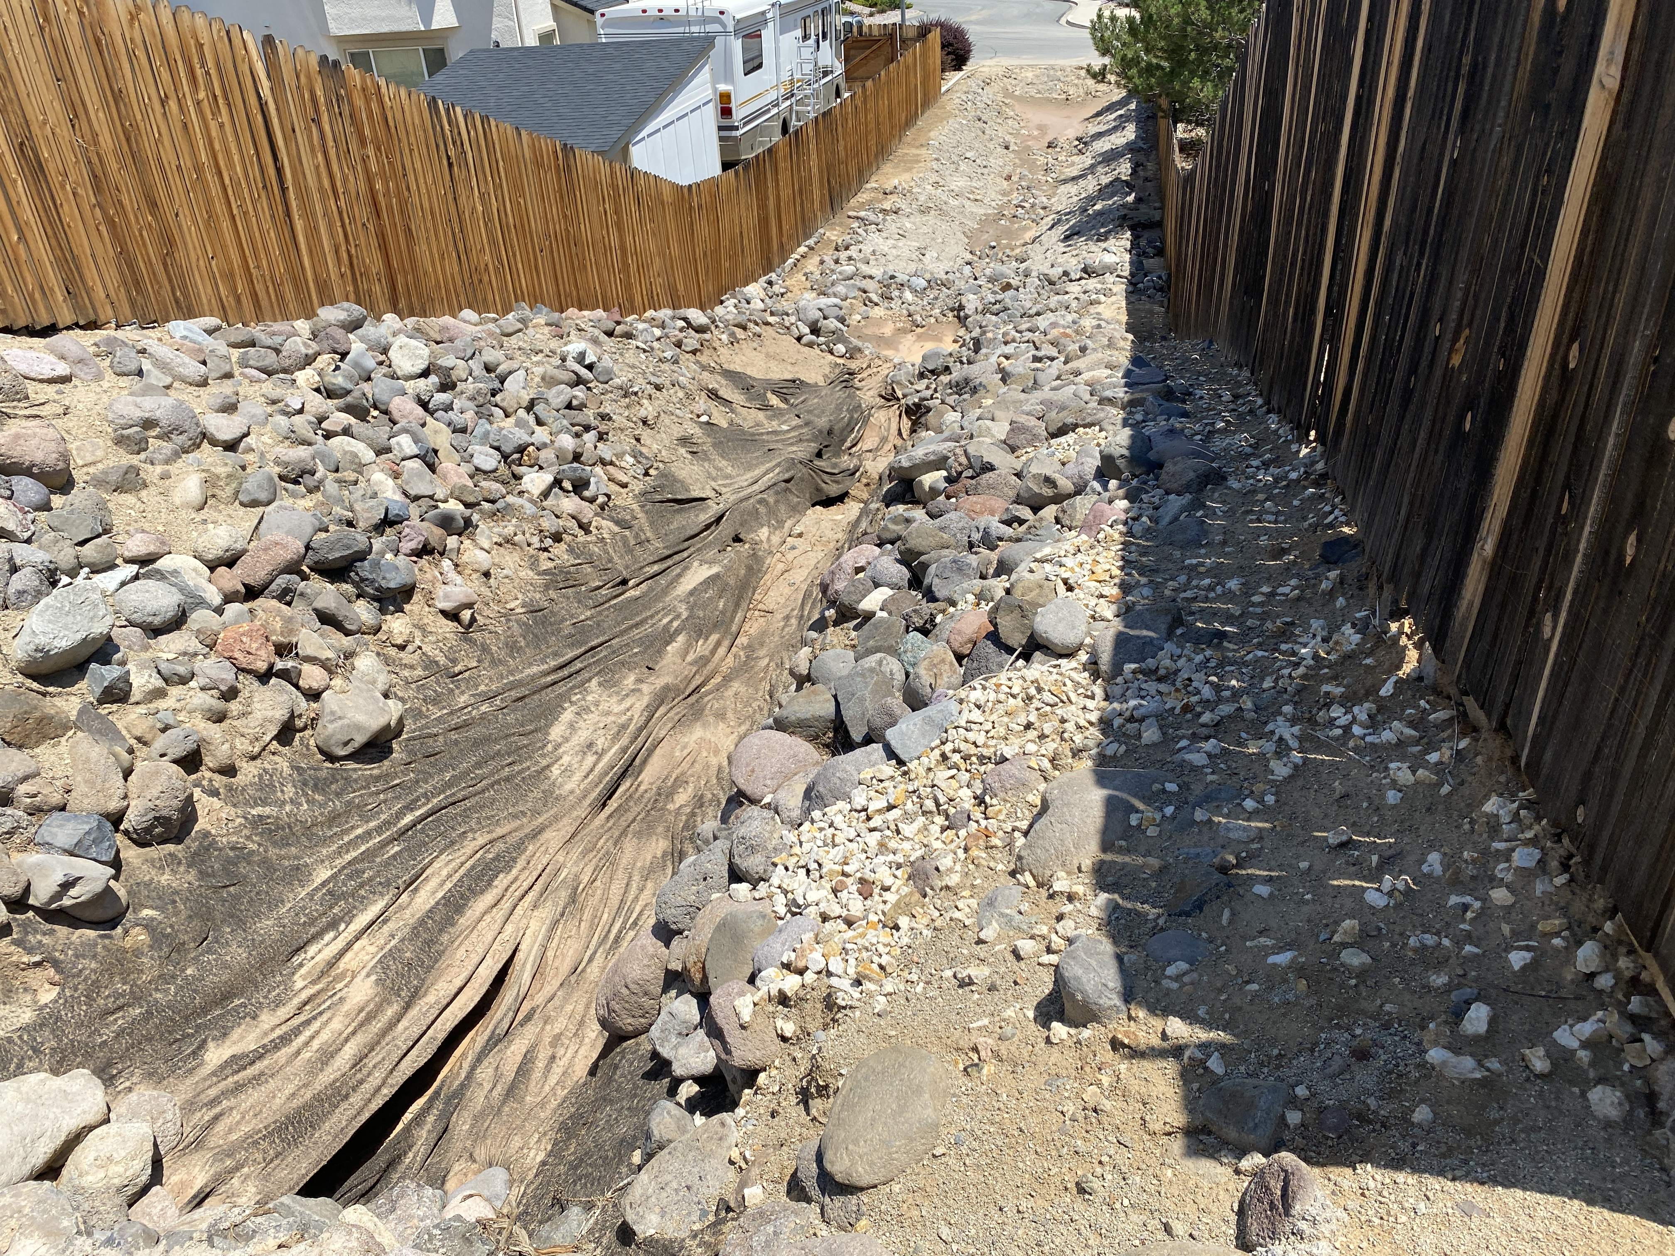
Storm event: July 31
Severe erosion in existing swale near the middle of the project
Proposed design includes concrete check dam weirs to mitigate flow velocity and prevent erosion

Slide 6
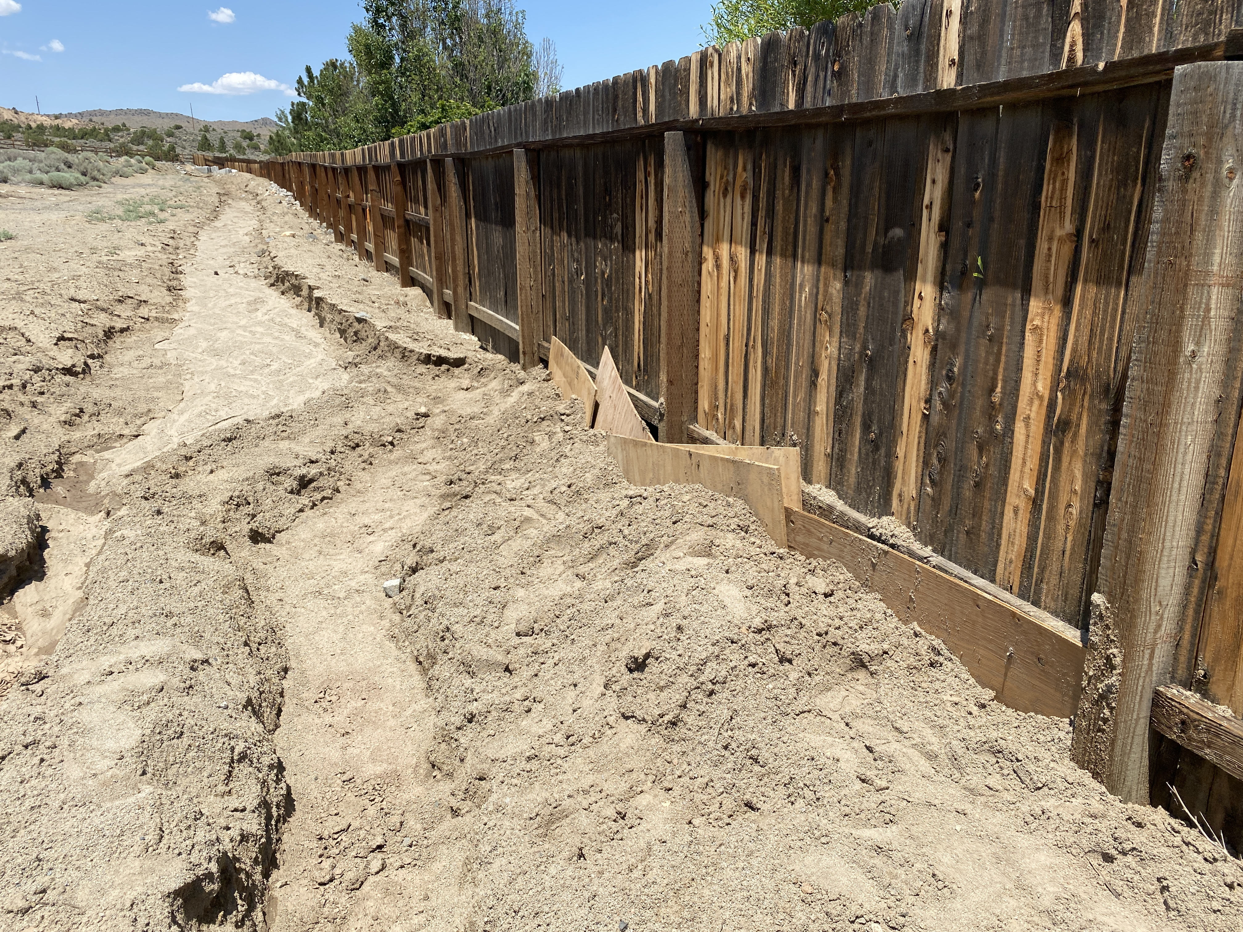
Storm event: July 31
Erosion and sediment buildup in temporary, non-stabilized swale and sediment buildup against residential fence
Proposed design includes enlarged swales and a concrete flood wall to protect the fence
Biannual and post-storm maintenance will still be required to remove sediment buildup in swales

Slide 7
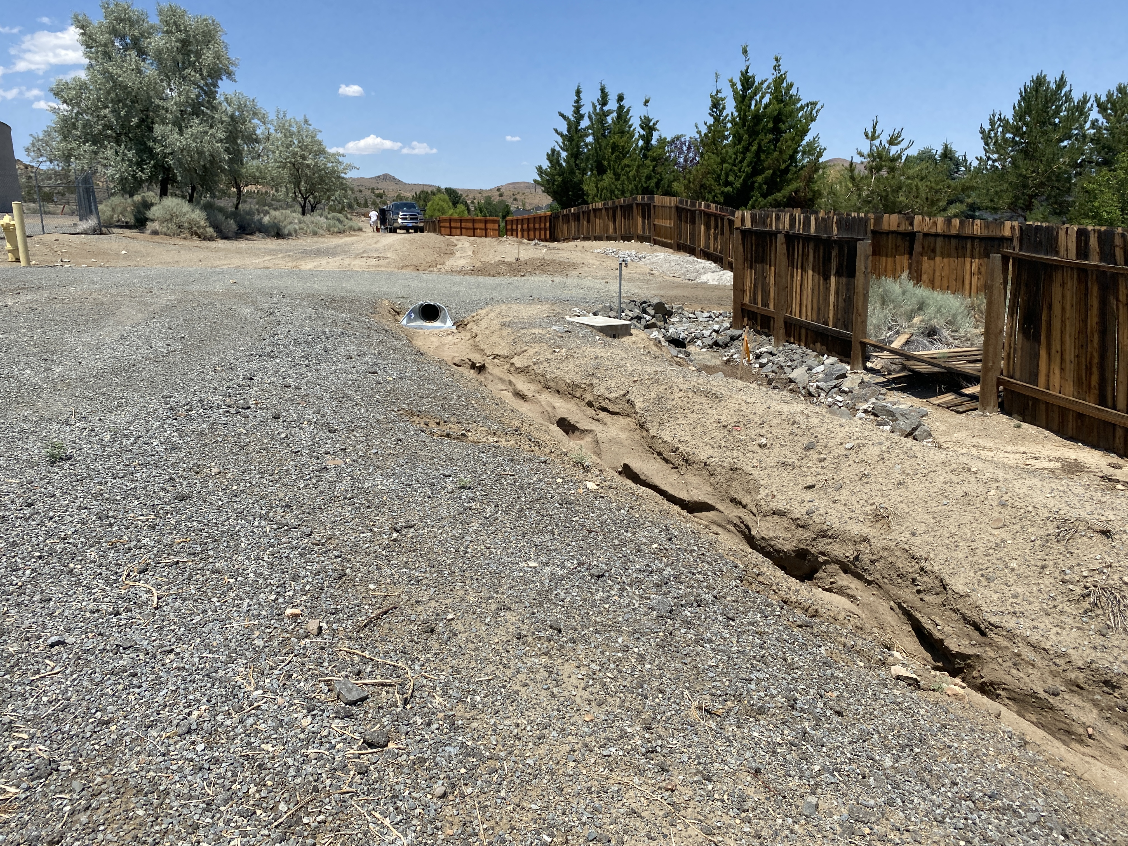
Storm event: July 31
Undersized corrugated metal pipe culvert installed by TMWA is overwhelmed by sediment
Proposed design will use a concrete box culvert for adequate capacity

Slide 8
Questions?
ANTICIPATED NEXT STEPS:
SUP CONDITIONS INCORPORATED INTO FINAL GRADING PLAN
GRADING PERMIT APPLICATION
APPROVAL TO CONSTRUCT
CONSTRUCTION IN 2021-2022
LANDSCAPE MAINTENANCE AGREEMENT UPDATE TO INCLUDE MONITORING AND SEDIMENT REMOVAL

